Slide 1
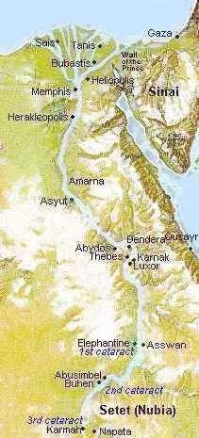
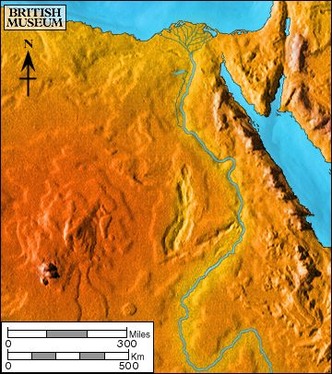
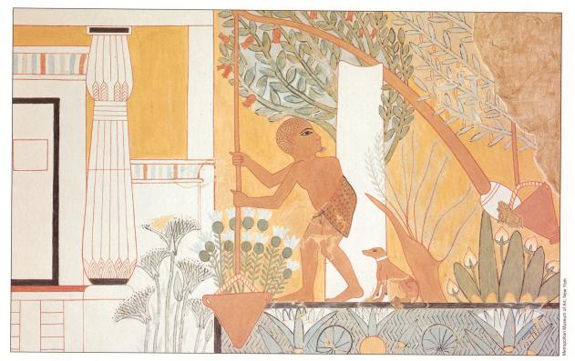
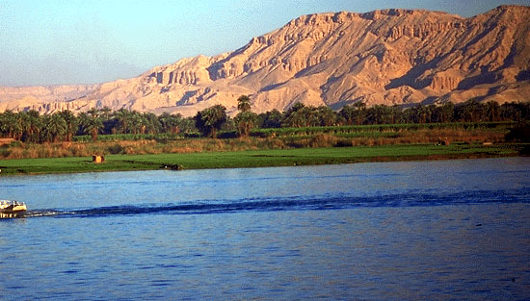
Chapter 2 Lecture Outline: “The Four Early River Valley Civilizations” (See your Packet, p. 15b)
Egypt on the Nile
I. GEOGRAPHY
Nile River
A. The Nile
1. Egypt’s settlements arose along narrow strip of land made
fertile by the river
2. Yearly flooding, but predictable
Regular cycle: flood, plant, harvest, flood, plant, harvest...
3. Intricate network of irrigation ditches
4. Worshiped as a god – giver of life and benevolent
Compare and Contrast…
Earlier we discussed the Sumerians and the effect their particular environment may have had on the way they viewed their gods.
Compare the Sumerian view to the Egyptian view and explain why the Egyptian view may have been so different.
WATCH VIDEO CLIP
Irrigating scene painted on tomb at Thebes

Slide 2
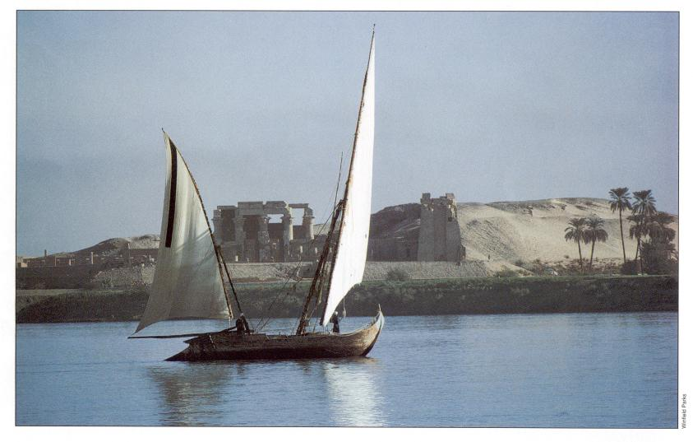
Examine this quote:
“Egypt, the gift of the Nile.”
~ Herodotus, Greek historian (484-432 B.C.E.)
What do you infer from this quote, what did Herodotus mean by it?
PP Design of T. Loessin; Akins H.S.

Slide 3
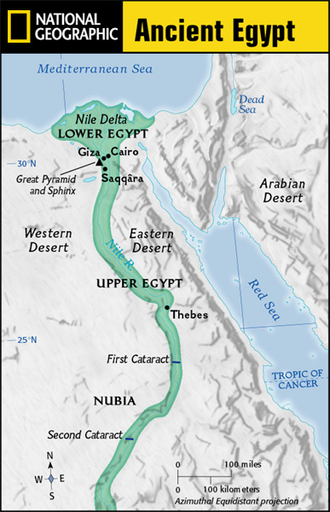
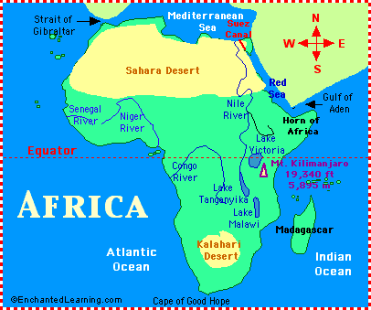
Chapter 2 Lecture Outline: “The Four Early River Valley Civilizations”
Egypt on the Nile
I. GEOGRAPHY
B. Upper and Lower Egypt
1. Most of Egypt’s history focused around
Lower Egypt,
around the Nile delta which flows into the Mediterranean Sea.
2. Upper Egypt developed later upstream
3. Nile provided reliable transportation
to go north, drift with the current toward the sea
- to go south, sail catching the Mediterranean breeze
C. Environment
1. Unlike Mesopotamia, the Nile was predictable
2. Deserts on both sides of Nile
- provided natural protection against invaders
- also reduced interaction with other people
Egypt would develop mostly in isolation and therefore, a culture that was quite unique.
PP Design of T. Loessin; Akins H.S.

Slide 4
Chapter 2 Lecture Outline: “The Four Early River Valley Civilizations”
Egypt on the Nile
II. UNITED EGYPT’S GOVERNMENT
A. Unlike Sumeria, no independent city-states in Egypt
B. Menes, the king of Upper Egypt,
1. united the two regions – Upper and Lower – in 3,100 B.C.E.
2. Capital: Memphis
3. Creates first Egyptian dynasty
C. The Pharaoh [means, royal house] – the ruler of Egypt
1. were considered gods; served both political and religious roles
Define
type of
government
Type of government where the political rulers are thought to be divinely-guided, or even divine themselves is a theocracy.
Before 3000 B.C., there was the white crown of Upper Egypt and the red crown of Lower Egypt. When Egypt was united, these two crowns were combined into the Double Crown of Upper and Lower Egypt.
PP Design of T. Loessin; Akins H.S.

Slide 5
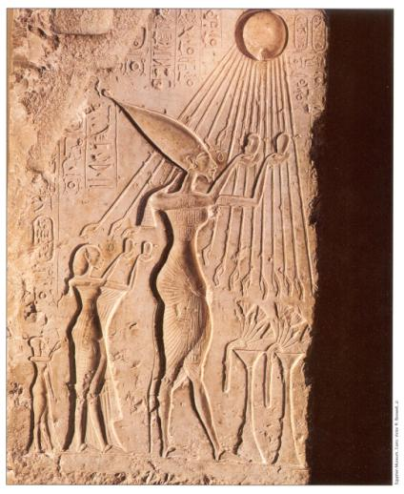
Chapter 2 Lecture Outline: “The Four Early River Valley Civilizations”
Egypt on the Nile
II. UNITED EGYPT’S GOVERNMENT
C. The Pharaoh [means, royal house] – the ruler of Egypt
1. were considered gods; served both political and religious roles
Define
type of
government
Type of government where the political rulers are thought to be divinely-guided, or even divine themselves is a theocracy.
2. Believed each pharaoh ruled even after death, because
they all possessed the same eternal spirit = ka;
and being gods, they naturally bore full responsibility for Egypt’s well-being.
The pharaoh Akenaton and his wife-sister Nefertiti worshiping the sun god, Ra.
PP Design of T. Loessin; Akins H.S.

Slide 6
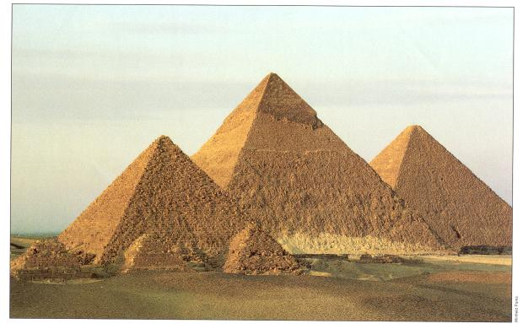
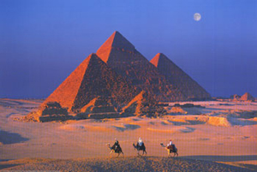
Chapter 2 Lecture Outline: “The Four Early River Valley Civilizations”
Egypt on the Nile
II. UNITED EGYPT’S GOVERNMENT
C. The Pharaoh [means, royal house] – the ruler of Egypt
1. were considered gods; served both political and religious roles
Define
type of
government
Type of government where the political rulers are thought to be divinely-guided, or even divine themselves is a theocracy.
2. Believed each pharaoh ruled even after death, because
they all possessed the same eternal spirit = ka;
and being god, naturally bore full responsibility for Egypt’s well-being.
3. Therefore, Pharaoh’s tomb very important, because it was still a place of rule.
Built massive tombs called pyramids.
The pyramids were built mainly in the
Old Kingdom Period.
What do we mean by…
the “Old Kingdom” period?
The Great Pyramids at Giza.
PP Design of T. Loessin; Akins H.S.

Slide 7
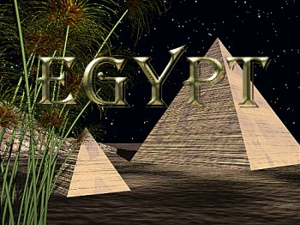
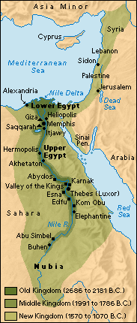
EARLY DYNASTIC PERIOD 2920-2575 BCE
Unification of Upper and Lower Egypt by Menes.
Foundation of the capital Memphis.
Early Step Pyramid is built at Saqqara.
OLD KINGDOM - 2660-2180 BCE
The Great Pyramids of Khufu (Cheops), Khafre (Chephren), Menkaure (Mycerinus) are built at Giza.
Pyramids of Sahure, Neferirkare, Raneferef, Neuserre are built at Abusir.
MIDDLE KINGDOM 2180-1550 BCE
Fragmentation of centralized power.
Kings in Thebes establish control over all Egypt.
Chaos leads central administration in Lower Egypt to disappear following infiltration by Hyksos,
an Asiatic people in the Nile Delta.
Upper Egypt dominated by kings in Thebes. (CH 2 Coverage)
----------------------------------------------- --------------------------------------- -----------------------------------------
NEW KINGDOM 1550-1070 BCE (CH 4 Coverage)
Theban king Ahmose expels the Hyksos and reunites Egypt.
Reigns of such kings as Amenhotep and Thutmose (Thutmosis). Memphis now main residential city.
Ramses II (1290- 1224 BC) divides power in Middle East with the Hittites; Qantir capital of Egypt.
Invasions of mysterious sea peoples wreck havoc throughout Mediterranean region.
------------------------------------------------------------------------------------------------------------------------------------------------------------------------------------------------------------------------------------------------------------------------
Future history….
Alexander the Great of Macedonia / Greece conquers and the Ptolemy dynasty governs; 332 – 30 BC
After the defeat of Cleopatra, the last Ptolemy ruler, the Roman emperors exploit Egypt as the main
production center of wheat, papyrus and textiles for the vast Roman Empire; 30 BC – 394 AD
PP Design of T. Loessin; Akins H.S.

Slide 8
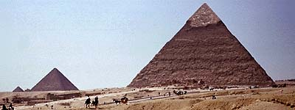
Chapter 2 Lecture Outline: “The Four Early River Valley Civilizations”
Egypt on the Nile
II. UNITED EGYPT’S GOVERNMENT
C. The Pharaoh [means, royal house] – the ruler of Egypt
1. were considered gods; served both political and religious roles
Define
type of
government
Type of government where the political rulers are thought to be divinely-guided, or even divine themselves is a theocracy.
2. Believed each pharaoh ruled even after death, because
they all possessed the same eternal spirit = ka;
and being god, naturally bore full responsibility for Egypt’s well-being.
3. Therefore, Pharaoh’s tomb very important, because it was still a place of rule.
Built massive tombs called pyramids.
The pyramids were built mainly in the
Old Kingdom Period.
What do you know?
What are some leading theories about how the enormous pyramids were constructed by the Egyptians over 4,000 years ago?
The Great Pyramids at Giza.
PP Design of T. Loessin; Akins H.S.

Slide 9
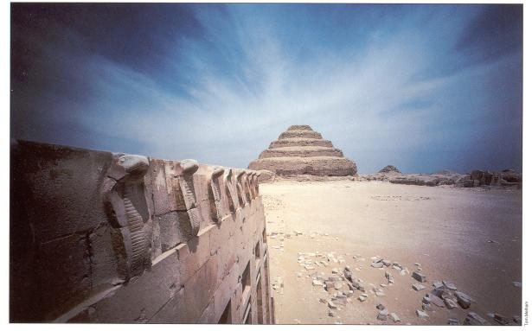
The pyramid at Saqqara is believed by archaeologists to be one of the earliest.
What is unusual about it? What clues does it offer to how the pyramids were built?
WATCH VIDEO CLIP
PP Design of T. Loessin; Akins H.S.

Slide 10
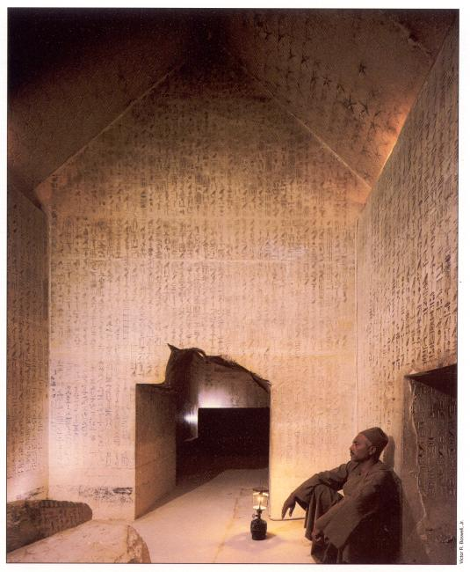
A modern-day Egyptian guide uses his Coleman lantern to illuminate the amazing hieroglyphic text covering the walls deep within the tunnels below the Saqqara pyramid.
PP Design of T. Loessin; Akins H.S.

Slide 11
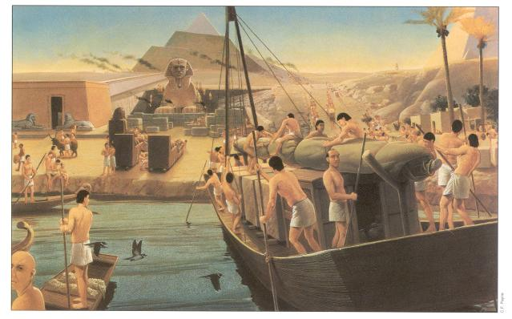
What details do you notice and what can you infer about how this artist thinks the pyramids
were built? Does this match the theory supported by the Saqqara pyramid?
An artist’s conception of the building of the great Khufu pyramid at Giza, Sphinx in foreground.
PP Design of T. Loessin; Akins H.S.

Slide 12
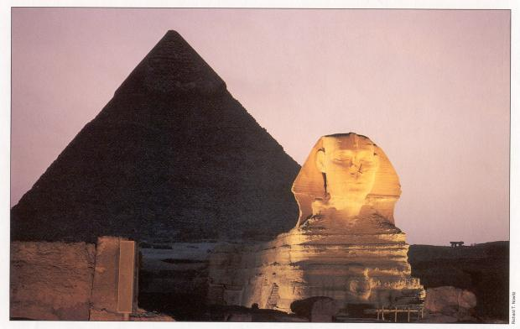
The Sphinx and Pyramid of Khafre at Giza.
PP Design of T. Loessin; Akins H.S.

Slide 13
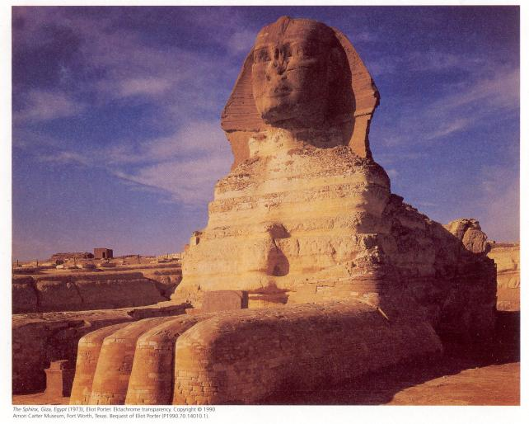
Take a panoramic view of the Sphinx at http://www.pbs.org/wgbh/nova/lostempires/obelisk/explore/sphinx.html
PP Design of T. Loessin; Akins H.S.

Slide 14
PP Design of T. Loessin; Akins H.S.

Slide 15
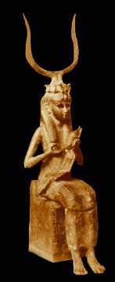
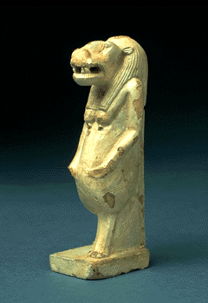
Chapter 2 Lecture Outline: “The Four Early River Valley Civilizations”
Egypt on the Nile
III. EGYPTIAN CULTURE
A. RELIGION
1. Polytheistic
a. Over 2,000
Ra, the sun god; Horus, sky god; Isis, mother goddess “giver of life” associated with Nile
Above: The pantheon of Egyptian gods*
Example of Religious Syncretism
Right: The depiction of the seated mother holding the suckling child Horus was a common painted image throughout Egypt and is reminiscent of the iconography of Mary and Jesus. Also, Horus, being the child of Osiris and Isis – the god of the living and the dead - would grow up to defeat the evil Seth and cast him into darkness. Seth eternally strives for revenge, battling Horus at every turn. When Horus wins, Maat (justice) is upheld and the world is at peace. Horus then protects us in this life. Given all that…can you see how the early Christians had an easy time marketing their new Roman religion to the Egyptians, particularly after convincing them that Mary, mother of Jesus, was an incarnation of Isis!
Right: Images of household gods were often displayed on altars in Egyptian homes. This is the goddess Taweret one of the most popular. Taweret protected mothers and their children against the risks during pregnancy and birth.
The goddess was usually depicted as a pregnant hippopotamus with the limbs and paws of a lion and a mane in the form of a crocodile's tail. Her frightening appearance was probably meant to scare away evil spirits.
ca. 712 - 332 B.C.
PP Design of T. Loessin; Akins H.S.
Notes:
Human and semihuman forms of some of the chief Egyptian deities: 1) Horus, son of Osiris, a sky god closely connected with the king. 2) Set or Seth, enemy of Horus and Osiris, god of storms and disorder. 3) Thoth, a moon deity and god of writing, counting and wisdom. 4) Khnum, a ram god who shapes men and their kas on his potter's wheel. 5) Hathor, goddess of love birth and death. 6) Sobek, the crocodile god, Lord of the Faiyum. 7) Ra, the sun god in his many forms. 8) Amon, a creator god often linked with Ra. 9) Ptah, another creator god and the patron of craftsmen. 1O) Anubis, god of mummification. 11) Osiris, god of agriculture and ruler of the dead. 12) Isis, wife of Osiris, mother of Horus and Mistress of Magic.

Slide 16
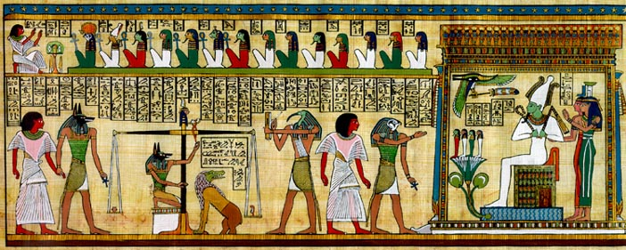
Chapter 2 Lecture Outline: “The Four Early River Valley Civilizations”
Egypt on the Nile
III. EGYPTIAN CULTURE
A. RELIGION
1. Polytheistic
a. Over 2,000
Ra, Sun god; Horus, sky god; Isis, goddess of fertility (associated with Nile – mother “giver of life”)
b. Belief in afterlife!
The Funerary Scene
This scene depicts what occurs after a person has died, according to the ancient Egyptians.
The Egyptians had an elaborate and complex belief in the afterlife.
PP Design of T. Loessin; Akins H.S.
Notes:
Beginning with the upper left-hand corner, the deceased appears before a panel of 14 judges to make an accounting for his deeds during life. The ankh, the key of life, appears in the hands of some of the judges.
Next, below, the jackal god Anubis who represents the underworld and mummification leads the deceased before the scale. In his hand, Anubis holds the ankh.
Anubis then weighs the heart of the deceased (left tray) against the feather of Ma'at, goddess of truth and justice (right tray). In some drawings, the full goddess Ma'at, not just her feather, is shown seated on the tray. Note that Ma'at's head, crowned by the feather, also appears atop the fulcrum of the scale. If the heart of the deceased outweighs the feather, then the deceased has a heart which has been made heavy with evil deeds. In that event, Ammit the god with the crocodile head and hippopotamus legs will devour the heart, condemning the deceased to oblivion for eternity. But if the feather outweighs the heart, and then the deceased has led a righteous life and may be presented before Osiris to join the afterlife. Thoth, the ibis-headed god of wisdom stands at the ready to record the outcome.
Horus, the god with the falcon head, then leads the deceased to Osiris. Note the ankh in Horus' hand. Horus represents the personification of the Pharaoh during life, and his father Osiris represents the personification of the Pharaoh after death.
Osiris, lord of the underworld, sits on his throne, represented as a mummy. On his head is the white crown of Lower Egypt (the north). He holds the symbols of Egyptian kingship in his hands: the shepherd's crook to symbolize his role as shepherd of mankind, and the flail, to represent his ability to separate the wheat from the chaff. Behind him stand his wife Isis and her sister Nephthys. Isis is the one in red, and Nephthys is the one in green. Together, Osiris, Isis, and Nephthys welcome the deceased to the underworld.
The tomb-owner would continue after death the occupations of this life and so everything required was packed in the tomb along with the body. Writing materials were often supplied along with clothing, wigs, and hairdressing supplies and assorted tools, depending on the occupation of the deceased.
Often model tools rather than full size ones would be placed in the tomb; models were cheaper and took up less space and in the after-life would be magically transformed into the real thing.
Things might include a headrest, glass vessels which may have contained perfume and a slate palette for grinding make-up.
Food was provided for the deceased and should the expected regular offerings of the descendants cease, food depicted on the walls of the tomb would be magically transformed to supply the needs of the dead.
Images on tombs might include a triangular shaped piece of bread (part of the food offerings from a tomb). Other images might represent food items that the tomb owner would have eaten in his lifetime and hoped to eat in the after-life.

Slide 17
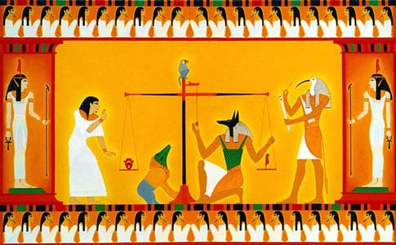
Chapter 2 Lecture Outline: “The Four Early River Valley Civilizations”
Egypt on the Nile
III. EGYPTIAN CULTURE
A. RELIGION
1. Polytheistic
a. Over 2,000
Ra, Sun god; Horus, sky god; Isis, goddess of fertility (associated with Nile – mother “giver of life”)
b. Belief in afterlife! The dead were judged by Osiris, god of the dead.
Osiris would weigh each person’s heart on a scale against the weight of a feather.
If the heart tipped the scale, heavy with sin, the Devourer of Souls would pounce on the heart.
If not, the soul would live forever in the Other World.
PP Design of T. Loessin; Akins H.S.

Slide 18
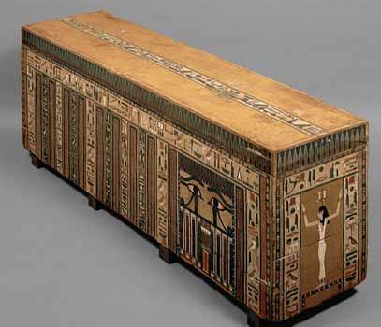
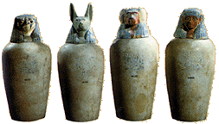
Chapter 2 Lecture Outline: “The Four Early River Valley Civilizations”
Egypt on the Nile
III. EGYPTIAN CULTURE
A. RELIGION
1. Polytheistic
a. Over 2,000
Ra, Sun god; Horus, sky god; Isis, goddess of fertility (associated with Nile – mother “giver of life”)
b. Belief in afterlife! The dead were judged by Osiris, god of the dead.
Desiring to make it to the Other World safely, Egyptians of all classes made special preparations for their burials, including
mummification – embalming and preserving the corpse to prevent it from decaying.
(See text, p. 40 “Something In Common”)
Above: Canopic jars for the body’s various organs.
Right: Coffin of a Middle Kingdom government official.
PP Design of T. Loessin; Akins H.S.

Slide 19
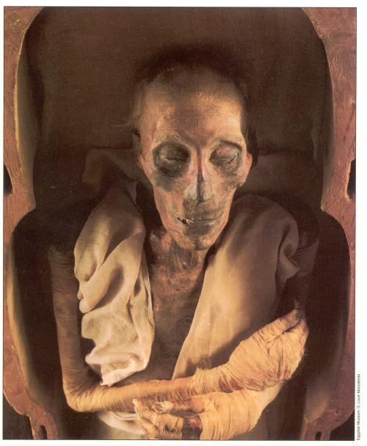
WATCH VIDEO CLIP
The mummy of Ramses II (1304 -1237 BC ) still preserved today, 3,200 years later,
at the Cairo Museum.

Slide 20
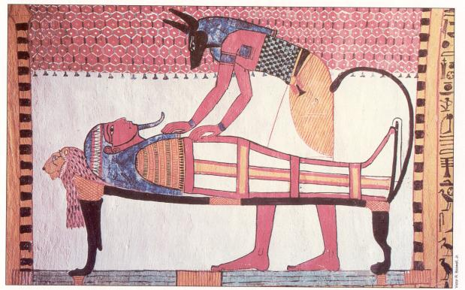
Annubis, god of embalming
PP Design of T. Loessin; Akins H.S.

Slide 21
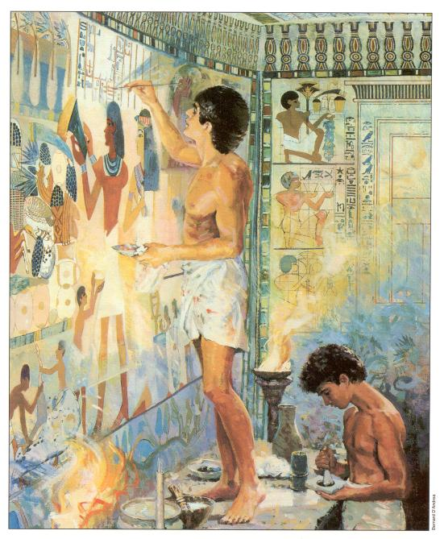
Young males educated as scribes paint the walls of a tomb in preparation for a burial.
PP Design of T. Loessin; Akins H.S.

Slide 22
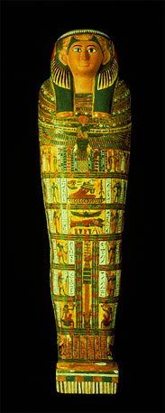
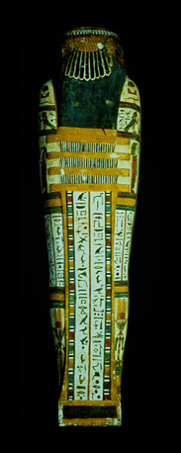
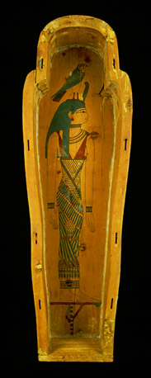
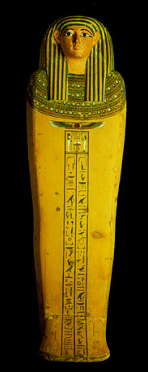
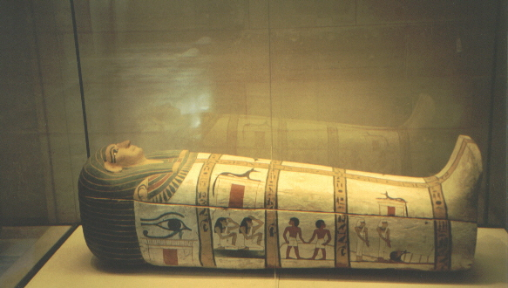
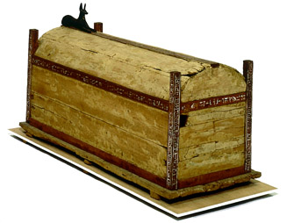
Egyptian coffins
PP Design of T. Loessin; Akins H.S.; photo British Museum

Slide 23
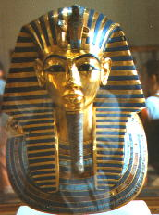
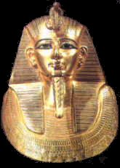
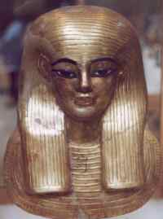
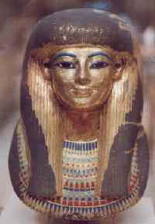
BURIAL MASKS
PP Design of T. Loessin; Akins H.S.
Notes:
The famous golden mask of Tutankhamun
and the less well known solid gold mask of Psusennes.
Tjuyu and Yuya - Parents of Queen Tiy - Mother of Akhnaton.

Slide 24
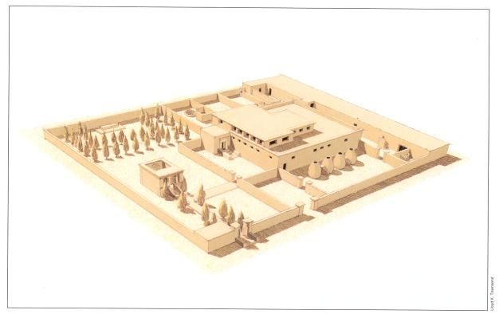
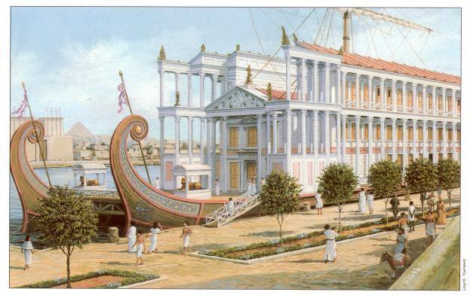
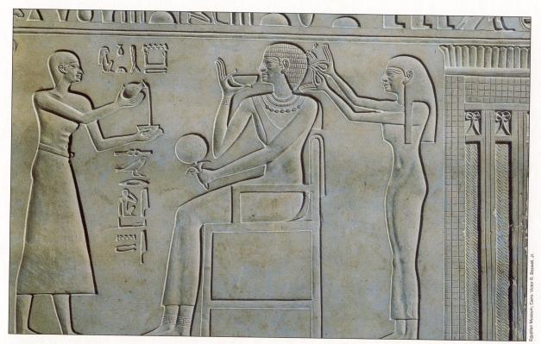
Chapter 2 Lecture Outline: “The Four Early River Valley Civilizations”
Egypt on the Nile
III. EGYPTIAN CULTURE
B. SOCIAL STRUCTURE
Royal Family
Upper class
Landowners (become familiar with other terms for this class – i.e., aristocracy or nobility)
Priests
Army commanders
Government officials
Wealthy man’s house at Amarna.
Royal barge of Ptolemy IV moored at Memphis.
Bas-relief of servants attending a royal lady.
PP Design of T. Loessin; Akins H.S.

Slide 25
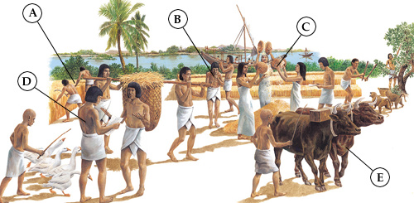
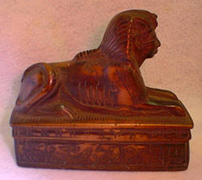
Chapter 2 Lecture Outline: “The Four Early River Valley Civilizations”
Egypt on the Nile
III. EGYPTIAN CULTURE
B. SOCIAL STRUCTURE
Royal Family
Upper class
Landowners (also known as aristocracy or nobility)
Priests
Army commanders
Government officials
Middle Class
(merchants / artisans)
Egyptian bronze spear points, 300 BCE
Lower class
(peasant farmers, unskilled laborers)
Socially Mobile classes
Not “locked in”,
lower and middle classes
could rise up through marriage or through merit (success).
Beautifully carved soapstone
Sphinx storage dish.
Middle Kingdom period
A. Harvesting grain; B. Musicians play for the workers in the fields; C. Women winnowing the grain; D. Scribes tally the farmer’s taxes; E. The farmer’s son tending the livestock / cattle.
PP Design of T. Loessin; Akins H.S.

Slide 26
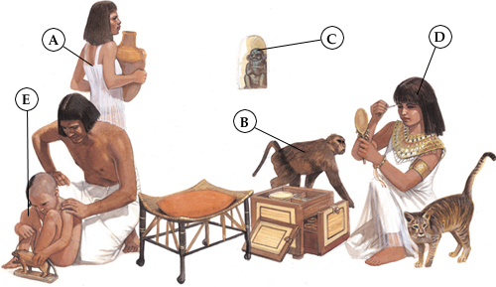
Chapter 2 Lecture Outline: “The Four Early River Valley Civilizations”
Egypt on the Nile
III. EGYPTIAN CULTURE
Did you know…
Men and women
wore makeup in Egypt.
The dark-lined eyes that look out at us from the artwork of ancient Egypt was the height of fashion and was called kohl – powdered minerals mixed with water and applied with a small stick. Both genders also wore lipstick – crushed red ocher (iron oxide) mixed with oil.
Read text p. 37 for more cool info. about
Egyptian cosmetics.
B. SOCIETY STRUCTURE
Royal Family
Upper class
Landowners (also known as aristocracy or nobility)
Priests
Army commanders
Government officials
Middle Class
(merchants / artisans)
Lower class
(peasant farmers, unskilled laborers
Socially Mobile classes
Not “locked in”,
lower and middle classes
could rise up through marriage or through merit (success).
2. Women had many of the
same rights as men,
could own property,
could seek divorce.
Later we’ll discover
a couple of women
who actually ruled Egypt!
PP Design of T. Loessin; Akins H.S.
Notes:
Among rich people, marriages were arranged. The king married foreign princesses for political reasons. Other marriages were based on love and respect. Husband and wife were often painted with arms around each other. Families were large, with five or six children. (A) SERVANTS A rich Egyptian family had servants to work for them. (B) PETS The Egyptians were fond of animals. They kept birds and monkeys, as well as cats and dogs. (C) A HOUSEHOLD GOD Gods lived in ordinary houses as well as temples. Bes was a favourite god during the New Kingdom. (D) BEAUTY TREATMENT Here a woman is making herself beautiful. After a thorough wash, she puts on her jewellery and does her hair. Then she makes up her face. Most important are the eyes. She gives them a dark outline with kohl. (E) CHILDREN The Egyptians enjoyed family life and liked children. Parents expected their children to respect them and obey them.

Slide 27
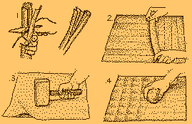
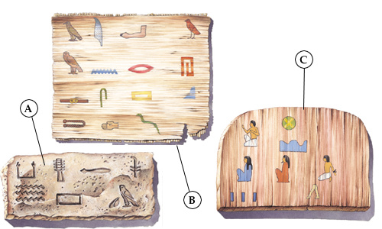
Chapter 2 Lecture Outline: “The Four Early River Valley Civilizations”
Egypt on the Nile
IV. EGYPTIAN WRITING
A. Pictographs developed into hieroglyphics
B. Written on Papyrus, unfurled reed from the Nile, dried into strips
C. Deciphering hieroglyphics
The Rosetta Stone, discovered in 1799 A.D.
Why was the knowledge of reading hieroglyphics LOST in the first place?
In the first century A.D. when Christianity arrived in Egypt,
it was common for the Christian movement to remove / destroy
the religious images, writings, and priesthood of the former religion in the region.
During this chaotic time of transition, the literate priests and scribes were mostly
killed off and the knowledge of hieroglyphics was lost for almost 1,500 years.
Read now in your textbook, p. 38 how it was that we once again “broke the code” and learned to read the mysterious language of the great Egyptian civilization.
PP Design of T. Loessin; Akins H.S.
Notes:
The Egyptians invented a form of writing called hieroglyphics. Hieroglyphs are little pictures. Some stand for an object. For example, a picture of a cow means 'cow.' But they also stand for sounds. In English, you could use the sign of a cow to write the first half of the word 'cow-ard.' The same sign would stand for different words that sound alike, such as 'see' and 'sea.' People wrote with a reed pen, or fine brush, and ink. (A) GROUP SIGNS (B) LETTER SIGNS (C) SENSE SIGNS

Slide 28
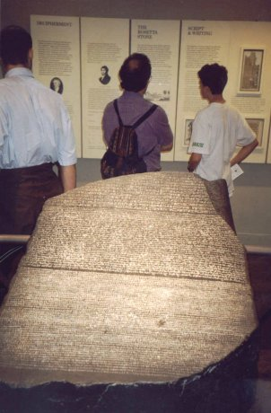
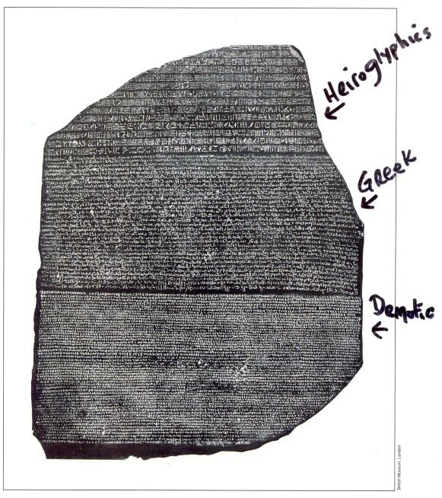
The Rosetta Stone, discovered in 1799 A.D.
The Rosetta Stone can be viewed by tourists today in the British Museum.
PP Design of T. Loessin; Akins H.S.

Slide 29
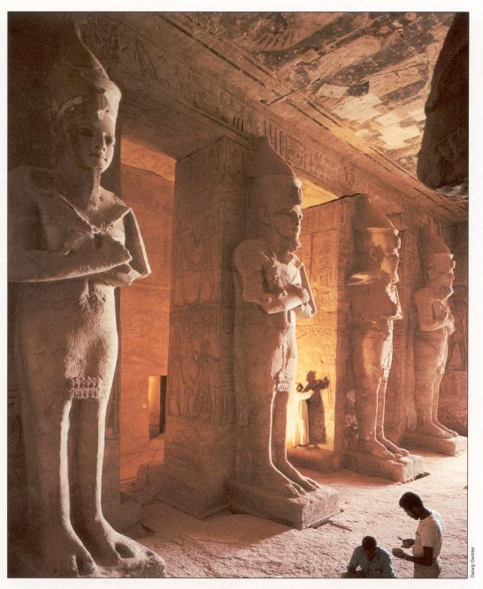
Chapter 2 Lecture Outline: “The Four Early River Valley Civilizations”
Egypt on the Nile
V. SCIENCE & TECHNOLOGY
A. Geometry, numeric system on base 10 (decimal), engineers and architects, first to use stone columns
B. Calendar
C. Amazing advancements in medicine
PP Design of T. Loessin; Akins H.S.

Slide 30
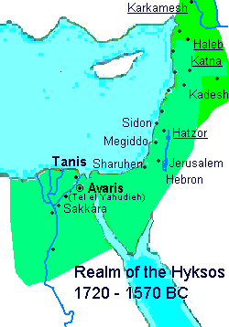
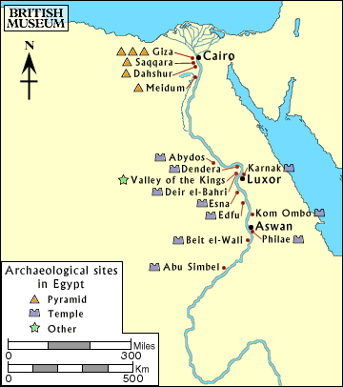
Chapter 2 Lecture: “Four Early River Valley Civilizations”
Egypt on the Nile
VI. INVASIONS
A. Old Kingdom begins to decline, ca. 2180 B.C.E.
After about a century of fragmented and weak rulers,
Middle Kingdom period rises [2080-1640 B.C.E.]
- Center of power is now in Thebes in Upper Egypt
rather than Lower Egypt’s old Memphis capital.
- This is a prosperous period.
Massive building projects around Thebes.
Unfortunately the Egyptians took their years of
well-protected geographic isolation for granted
and made little real defensive preparations
should the unthinkable happen.
The unthinkable happened.
Thebes
N
I
L
E G Y P T
R.
C. Invaded by the Hyksos, an Asiatic people, great chariot-riders –
which they introduced in Egypt for the first time.
These foreigners bring the Middle Kingdom period to an end
and will rule Egypt for 70 years.
PP Design of T. Loessin; Akins H.S.

