Slide 1
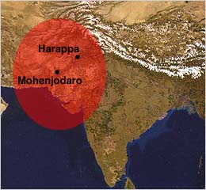
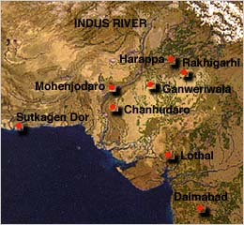
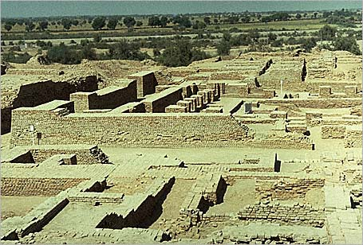
The Indus Valley civilization flourished around 2,500 B.C.
in the western part of South Asia,
in what today is Pakistan and western India.
It is often referred to as Harappan Civilization
after its first discovered city, Harappa.
The nearby city of
MohenjoDaro is the largest and most
familiar archaeological dig in this region. The Indus Valley was home to
the largest of the four ancient
urban civilizations of Egypt,
Mesopotamia, India and China.
This ancient civilization was not discovered
until the 1920's.
Most of its ruins, including
major cities, remain to be excavated.
Left: The excavated ruins of Mohenjo-daro.
PP Design of T. Loessin; Akins H.S.

Slide 2
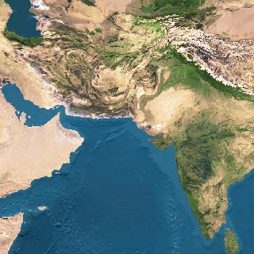
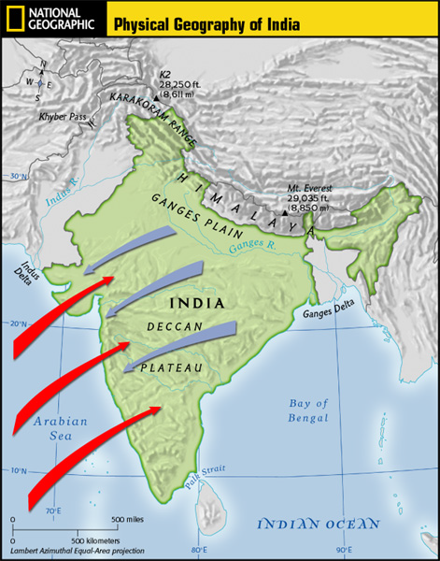
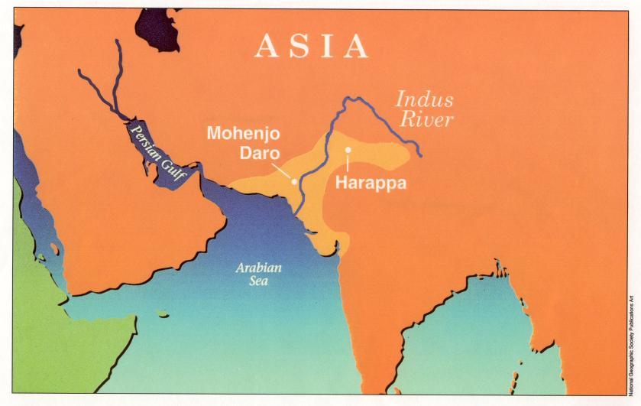
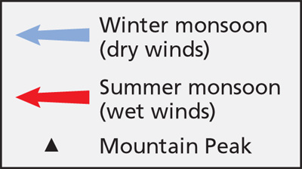
CH 2: Sec. 3 “Planned Cities on the Indus”
Homework packet p.
1. What challenges did the people along
the Indus River face?
unpredictable rivers
(similar situation to Mesopotamia region)
strong winds / monsoons
PP Design of T. Loessin; Akins H.S.

Slide 3
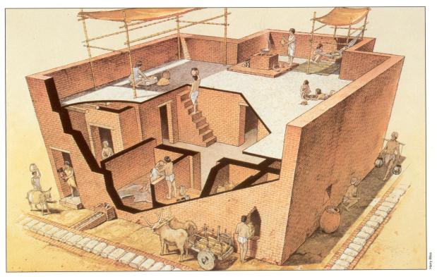
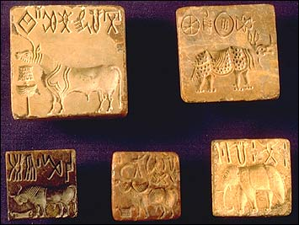
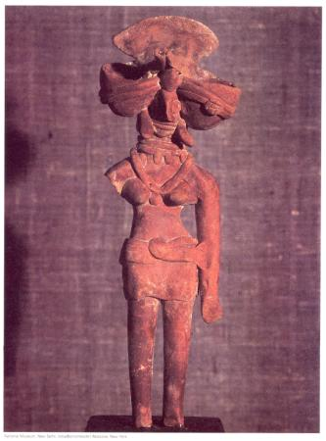
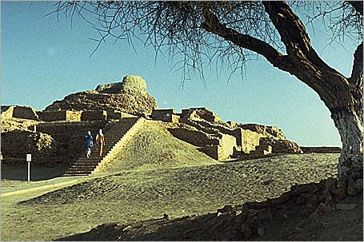
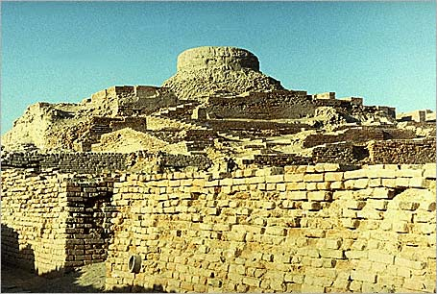
CH 2: Sec. 3 “Planned Cities on the Indus”
Homework packet p.
Did you know?
Hinduism is considered to be
the world’s oldest religion.
Yet it’s origins have long been a mystery.
2. Name conclusions that have been drawn
about Indus River culture?
Began farming along Indus about 3,200 B.C.
Size of settled region larger
than Egypt or Mesopotamia.
Careful city planners; laid out in grid
with a defendable citadel.
Engineered sophisticated plumbing and sewage systems.
Peaceful people – few weapons found
Similarity in housing indicates little differences
between social classes.
Religious objects and symbols clearly linked to Hinduism.
Indus Harappan script has not been deciphered.
This means basic questions about
the people who created this highly complex culture
are still unanswered.
Typical Harappan dwellling
Above: Terracota household statues such as this female goddess are found frequently in the region. Is this religious icon an early Shiva? Does modern Hinduism have its origins in Harappan civilization?
Left: The excavated ruins of Mohenjodaro – one of several planned cities laid out on a grid system in the Indus region.
Right: The citadel at Mohenjodaro.

Slide 4
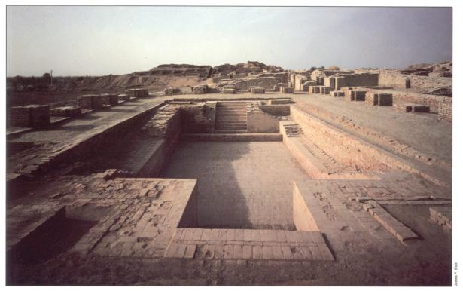
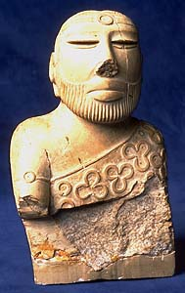
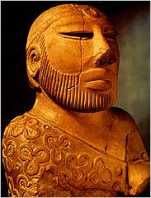
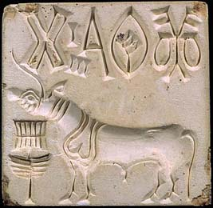
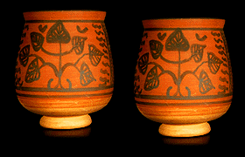
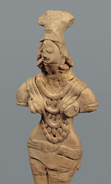
What happened to the Harappan civilization on the Indus River?
Above: The Great Bath at Mohenjo-Daro.
Surrounding pics: various Harappan artifacts.
PP Design of T. Loessin; Akins H.S.
Notes:
String of beads, ca. 2600–1900 B.C.; Harappan. Indus Valley, Mohenjo-daro, DK 1541. Gold, vesuvianite or grossular garnet, agate, jasper, and steatite; L. 18 cm (7 1/8 in.). Mohenjo-daro Museum, Mohenjo-daro MM 1367. Courtesy of the Department of Archaeology and Museums, Ministry of Minorities, Culture, Sports, Tourism, and Youth Affairs, Government of Pakistan.
Female figures with headdresses and jewelry, ca. 2600–1900 B.C.; Harappan. Indus Valley, Mohenjo-daro, DK 2384. Terracotta; H. 18.7 cm (7 3/8 in.); W. 9.5 cm (3 3/4 in.). National Museum, Karachi. This figure from Mohenjo-daro represents one of the main styles of female figures found in cities as well as smaller settlements throughout the Indus Valley region. The fan-shaped headdress originally had wide cup-shaped extensions on either side of the head, framed by braided tresses.

Slide 5
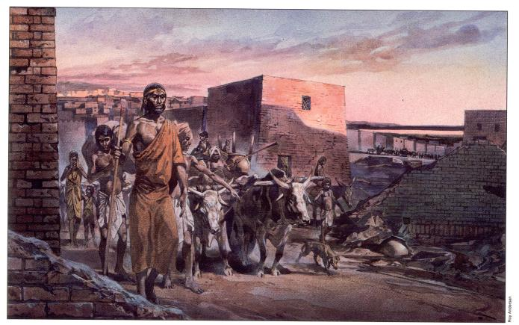
CH 2: Sec. 3 “Planned Cities on the Indus”
Homework packet p.
3. Name three theories about why the Indus Valley
civilization ended around 1500 BCE?
The river may have changed course, natural disaster
(caused by heavy monsoons)
The people may have overworked the land
(overcutting trees, overgrazed, overfarmed land depleting nutrients)
Invaders
(What is the disputed (A.I.T.) Aryan Invasion Theory?)
Harappans abandoning their city.
PP Design of T. Loessin; Akins H.S.

Slide 6
