Slide 1
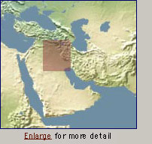
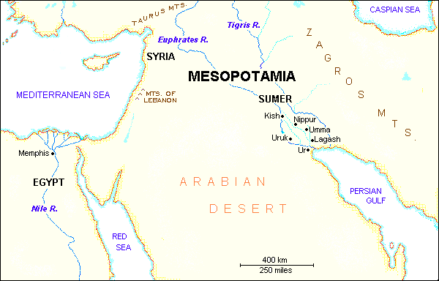
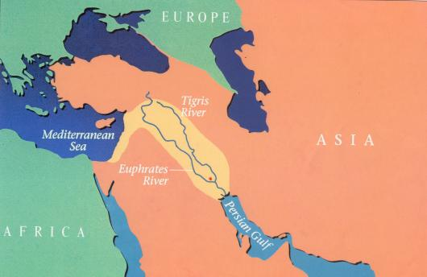
Chapter 2 Lecture Outline: “The Four Early River Valley Civilizations”
City-States in Mesopotamia
I. GEOGRAPHY
A. Mostly dry desert climate in SW Asia (Middle East)
1. Except in region between Tigris / Euphrates rivers
2. a flat plain known as Mesopotamia lies between the
two rivers
3. Because of this region’s shape and the richness of its soil,
it is called the Fertile Crescent.
- the rivers flood at least once a year,
leaving a thick bed of mud called silt.
SW Asia
(the Middle East)
Fertile Crescent
PP Design of T. Loessin; Akins H.S.

Slide 2
Chapter 2 Lecture Outline: “The Four Early River Valley Civilizations”
City-States in Mesopotamia
I. GEOGRAPHY
3. Because of this region’s shape and the richness of it’s soil,
it is called the Fertile Crescent.
- the rivers flood at least once a year,
leaving a thick bed of mud called silt.
Sumerians were first to settle in this region, attracted by the rich soil.
B. Three Disadvantages / Environmental Challenges
1. Unpredictable flooding / dry summer months
2. No natural barriers for protection
- small villages lying in open plain were defenseless
3. Limited natural resources
- stone, wood, metal
PP Design of T. Loessin; Akins H.S.
PP Design of T. Loessin; Akins H.S.

Slide 3
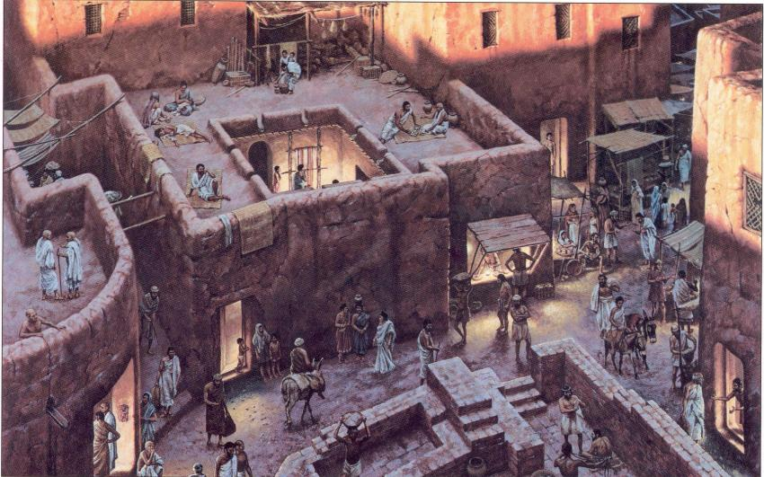
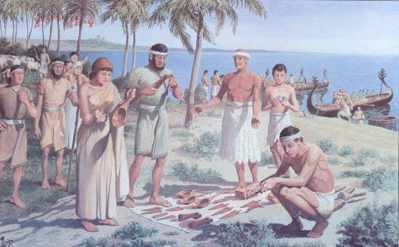
Chapter 2 Lecture Outline: “The Four Early River Valley Civilizations”
City-States in Mesopotamia
I. GEOGRAPHY
Sumerians were first to settle in this region, attracted by the rich soil.
B. Three Disadvantages / Environmental Challenges
1. Unpredictable flooding / dry summer months
2. No natural barriers for protection
- small villages lying in open plain were defenseless
3. Limited natural resources (stone, wood, metal)
C. Solutions
Sumerian innovations in achieving civilization
set example others would follow.
But to arrive at these solutions,
required organized government.
Let’s now look at the type of government the Sumerians had.
1. Irrigation ditches
2. Built city walls with
mud bricks
3. Traded with people
around them
for the products
they lacked.
Initiated Bronze Age.
PP Design of T. Loessin; Akins H.S.
PP Design of T. Loessin; Akins H.S.

Slide 4
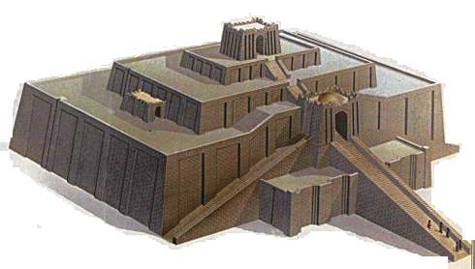
Chapter 2 Lecture Outline: “The Four Early River Valley Civilizations”
City-States in Mesopotamia
II. The City-State Structure of Government
A. Although all the cities shared the same culture …
Define
type of
government
each city had its own government / rulers, warriors,
it’s own patron god, and functioned like an independent country
C. includes within the city walls and also the surrounding farm land
D. Examples include Sumerian cities of Ur, Uruk, Kish, Lagesh
E. At center of each city was the walled temple with a ziggurat – a massive, tiered, pyramid-shaped structure.
PP Design of T. Loessin; Akins H.S.

Slide 5
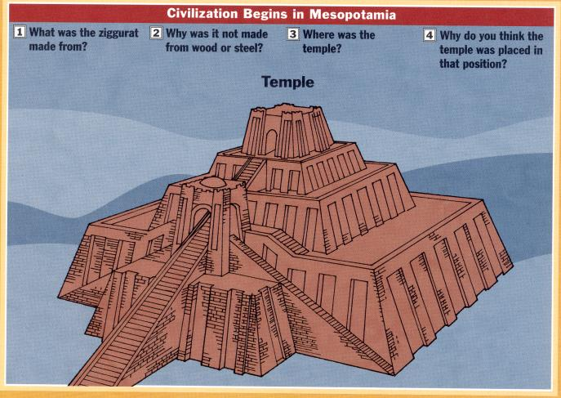
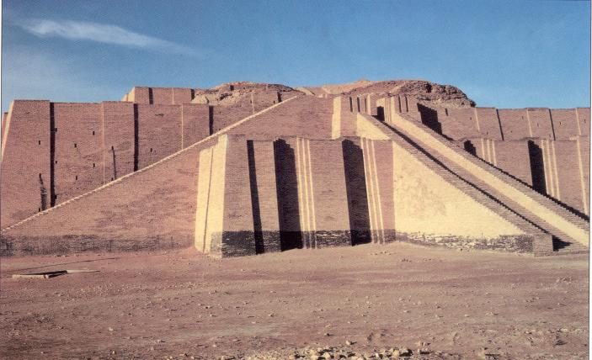
The Ziggurat at Ur was first excavated by British archaeologist Woolley in 1923.
The Iraqi Directorate of Antiquities restored its lower stages in the 1980s.

Slide 6
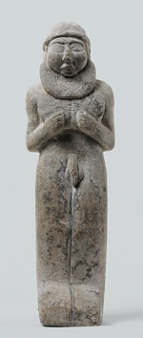
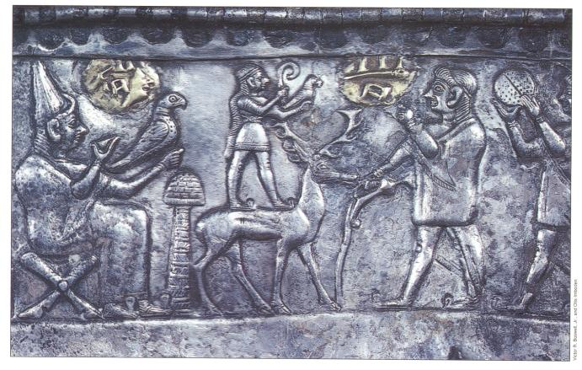
Chapter 2 Lecture Outline: “The Four Early River Valley Civilizations”
City-States in Mesopotamia
II. The City-State Structure of Government
A. Although all the cities shared the same culture …
Define
type of
government
each city had its own government / rulers, warriors,
it’s own patron god, and functioned like an independent country
C. includes within the city walls and also the surrounding farm land
D. Examples include Sumerian cities of Ur, Uruk, Kish, Lagesh
At center of each city was the walled temple with a
ziggurat – a massive, tiered, pyramid-shaped structure.
F. Powerful priests held much political power in the beginning.
Right: Standing nude
"priest-king,"
ca. 3300–3000 B.C.;
Uruk.
Left: Bas-relief
depicting priests
intervening between
worshipers and gods.
PP Design of T. Loessin; Akins H.S.

Slide 7
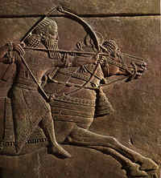

Chapter 2 Lecture Outline: “The Four Early River Valley Civilizations”
City-States in Mesopotamia
II. The City-State Structure of Government
A. Although all the cities shared the same culture …
Define
type of
government
each city had its own government / rulers, warriors,
it’s own patron god, and functioned like an independent country
C. includes within the city walls and also the surrounding farm land
D. Examples include Sumerian cities of Ur, Uruk, Kish, Lagesh
E. At center of each city was the walled temple with a ziggurat – a massive, tiered, pyramid-shaped structure.
F. Powerful priests held much political power in the beginning.
G. Military commanders eventually became ruler / monarch
- then began passing rule to their own heirs,
creating a new structure of government called a
Dynasty – a series of rulers descending from a single family line.
Define
type of
government
Historians wonder…
Did the Sumerians develop this new type of government on their own, or did they learn and adopt it only after contact with other peoples –
cultural diffusion?
PP Design of T. Loessin; Akins H.S.

Slide 8
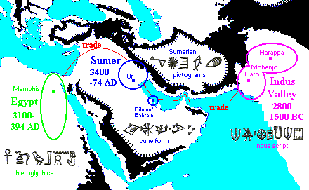
Cultural diffusion is the spread of elements of one culture to another people,
generally through trade.
Take the spread of writing. Similarities between the pictograms of Egyptian hieroglyphics, Sumerian cuneiform, and the Indus script are striking.
Can you give examples of cultural diffusion in your society today?
PP Design of T. Loessin; Akins H.S.

Slide 9
Chapter 2 Lecture Outline: “The Four Early River Valley Civilizations”
City-States in Mesopotamia
II. The City-State Structure of Government
A. Although all the cities shared the same culture …
each city had its own government / rulers, warriors,
it’s own patron god, and functioned like an independent country
C. includes within the city walls and also the surrounding farm land
D. Examples include Sumerian cities of Ur, Uruk, Kish, Lagesh
E. At center of each city was the walled temple with a ziggurat – a massive, tiered, pyramid-shaped structure.
F. Powerful priests held much political power in the beginning.
G. Military commanders eventually became ruler / monarch
- then began passing rule to their own heirs,
creating a new structure of government called a
Dynasty – a series of rulers descending from a single family line.
Through their trade with neighboring peoples, the Sumerians
spread their new innovations. This is cultural diffusion – the
spread of one culture’s ideas, products, traditions, beliefs etc.
to another people.
Let’s now examine Sumerian beliefs and other elements of their culture.
PP Design of T. Loessin; Akins H.S.

Slide 10
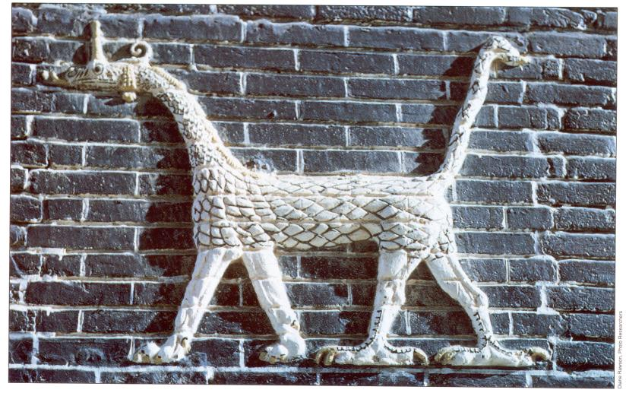
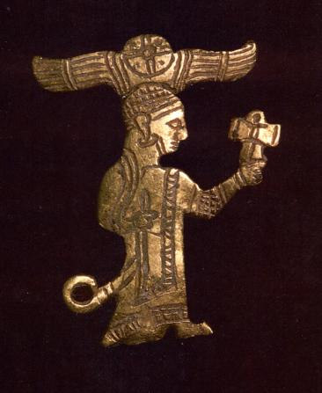
Chapter 2 Lecture Outline: “The Four Early River Valley Civilizations”
City-States in Mesopotamia
III. SUMERIAN CULTURE
A. RELIGION
1. Belief in many gods - polytheism
God of the clouds / air was Enlil – the most powerful god.
(Nearly 3,000 others – with human qualities.
The Sumerians viewed their gods as hostile and unpredictable –
similar to the natural environment around them.)
Reflection Time:
How does what’s happening to people
at any given moment affect how they think about their God(s)?
A Sumerian warrior-god, gold figurine, ca. 2,400-2,500 B.C.E.
Marduk, the Dragon god
PP Design of T. Loessin; Akins H.S.

Slide 11
Chapter 2 Lecture Outline: “The Four Early River Valley Civilizations”
City-States in Mesopotamia
III. SUMERIAN CULTURE
A. RELIGION
1. Belief in many gods - polytheism
God of the clouds / air was Enlil – the most powerful god.
(Nearly 3,000 others – with human qualities.
They were viewed as often hostile and unpredictable – similar to the
natural environment around them.)
2. Gilgamesh Epic, one of the earliest works of literature.
Contains a “flood story” that predates the Hebrew Old Testament story
of Noah by at least 2,000 years.
PP Design of T. Loessin; Akins H.S.

Slide 12
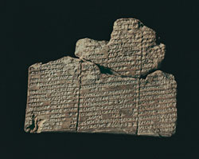

DID YOU KNOW…
Like many ancient civilizations, the Sumerians also had “a flood story.”
That’s not surprising given their challenging environment sitting
between two unpredictable rivers…in their view, such a
cataclysmic event did, indeed, destroy their “entire world.”
The Epic of Gilgamesh is, perhaps, the oldest written story on Earth.
It comes to us from ancient Sumeria, and was originally written on
12 clay tablets in cuneiform script. It is about the adventures of the
cruel King Gilgamesh of Uruk (ca. 2750 and 2500 BCE).
In tablet XI we read about Per-napishtim, a man who built a boat
and was saved from a great flood brought about by angry gods.
On p. 77 in your textbook you can compare Per-napishtim’s story to Noah’s story in the biblical book of Genesis as well as a “flood story” from India.
Tablet XI
COOL WEBSITE to visit:
GILGAMESH
Great website to visit: http://gilgamesh.psnc.pl/
PP Design of T. Loessin; Akins H.S.

Slide 13
Chapter 2 Lecture Outline: “The Four Early River Valley Civilizations”
City-States in Mesopotamia
III. SUMERIAN CULTURE
A. RELIGION
1. Belief in many gods - polytheism
God of the clouds / air was Enlil – the most powerful god.
(Nearly 3,000 others – with human qualities.
They were viewed as often hostile and unpredictable – similar to the
natural environment around them.)
2. Gilgamesh Epic, one of the earliest works of literature.
Contains a “flood story” that predates the Hebrew Old Testament story
of Noah by at least 2,000 years.
PP Design of T. Loessin; Akins H.S.

Slide 14
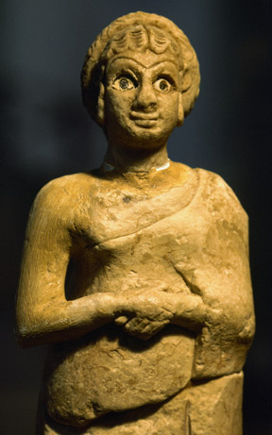
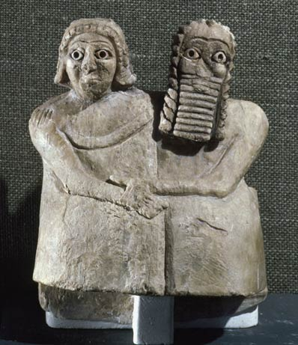
Chapter 2 Lecture Outline: “The Four Early River Valley Civilizations”
City-States in Mesopotamia
III. SUMERIAN CULTURE
B. SOCIETY
Three social classes
a. Priests and royalty (kings)
b. Wealthy merchants
c. Ordinary workers
[Slaves] –were not free citizens and thus not included in class system
2. Women
Had more rights than in many later civilizations
(could own property, join lower ranks of priesthood)
But not allowed to attend schools
(could not read or write)
Left: Statue of Sumerian woman with hands clasped at chest,
ca. 2600-2300 B.C. Right: Gypsum statue of man and
woman at Inanna Temple at Nippur, circa 2600-2300 B.C.

Slide 15
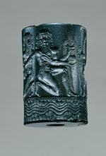
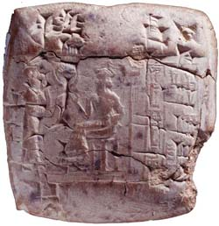
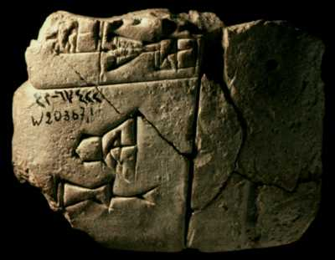
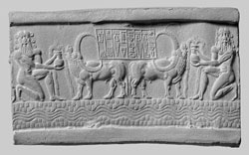
Chapter 2 Lecture Outline: “The Four Early River Valley Civilizations”
City-States in Mesopotamia
III. SUMERIAN CULTURE
C. SCIENCE & TECHNOLOGY
1. One of the first writing systems - Cuneiform
Cylinder seals and their ancient impressions on administrative documents and locking devices are
our richest source for a range of meaningful subject matters.
A wealth of these have been discovered at Sumerian sites. *
PP Design of T. Loessin; Akins H.S.
Notes:
Cylinder seal of Ibni-sharrum, a scribe of Shar-kali-sharri (left) and impression (right), ca. 2183–2159 B.C.; Akkadian, reign of Shar-kali-sharri. Mesopotamia. Cuneiform inscription in Old Akkadian. Serpentine; H. 3.9 cm (1 1/2 in.); Diam. 2.6 cm (1 in.). Musée du Louvre, Département des Antiquités Orientales, Paris AO 22303.
This seal, which according to the cuneiform inscription belonged to Ibni-sharrum, the scribe of king Shar-kali-sharri, is one of the finest examples of the perfection achieved by the engravers of the Akkadian period. Two nude heroes with long curls are represented kneeling on one knee in a strictly symmetrical composition. Each of them holds a vase with water gushing forth, a symbol of fertility and abundance; two water buffalo are drinking from them. Underneath, a river winds its way between the mountains, represented in a conventional manner by a motif composed of two lines of scales. In the center of the composition, the text panel containing the inscription is supported on the backs of the buffalo. These animals are evidence of the relations existing between the Akkadian Empire and the region of Meluhha, identified with the Indus Valley, where they originated. The engraver carefully detailed their powerful musculature and their spectacular horns, which he depicted as they appear on Indus seals in a view from above. The calm equilibrium of the composition, based on horizontal and vertical lines, confers on this minuscule relief a monumentality entirely characteristic of the late Akkadian period style. Seals of this quality were the monopoly of relatives of the royal family or of high officials, and probably came from a workshop, where production was reserved for these elite figures.

Slide 16
Chapter 2 Lecture Outline: “The Four Early River Valley Civilizations”
City-States in Mesopotamia
III. SUMERIAN CULTURE
C. SCIENCE & TECHNOLOGY
1. One of the first writing systems - Cuneiform
Invented wheel, the sail, the plow
First to use bronze.
Other Sumerian Achievements
(see textbook p. 31)
one of the earliest sketched maps
astronomy
a number system in base 60
from which stems our modern units of measuring time
and the 360 degrees of a circle.
PP Design of T. Loessin; Akins H.S.

Slide 17
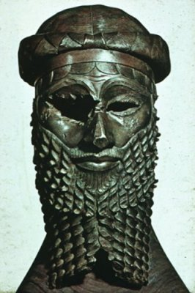
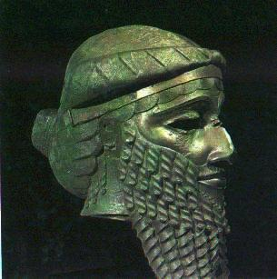
Chapter 2 Lecture Outline: “The Four Early River Valley Civilizations”
City-States in Mesopotamia
IV. First EMPIRE Builders
3,000 – 2,000 B.C.E. the City-States began to war with each other.
These internal struggles meant they were too weak to ward off an attack
by an outside enemy.
B. Sargon of Akkad (ca. 2,350 B.C.E.)
1. Took control of the region, creating world’s first empire -
when several peoples, nations, or previously independent
states are placed under the control of one ruler.
Define
type of
government
PP Design of T. Loessin; Akins H.S.

Slide 18
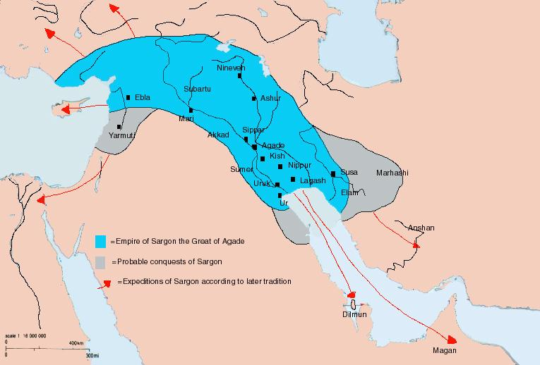
2. The Akkadian Empire lasted about 200 years, 2350 – approx. 2150 B.C.E.
PP Design of T. Loessin; Akins H.S.

Slide 19
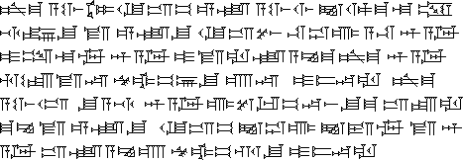

Chapter 2 Lecture Outline: “The Four Early River Valley Civilizations”
City-States in Mesopotamia
IV. First EMPIRE Builders
3,000 – 2,000 B.C.E. the City-States began to war with each other.
These internal struggle meant they were too weak to ward off an attack
by an outside enemy.
B. Sargon of Akkad (ca. 2,350 B.C.E.)
1. Took control of the region, creating world’s first empire -
bringing together several peoples, nations, or previously
independent states and place them under the control
of one ruler.
Define
type of
government
2. The Akkadian Empire lasted about 200 years
3. Spoke a Semitic language (related to Arabic and Hebrew)
Invasions,
internal fighting,
and a severe famine
all contributed to the end of the Akkadian Empire.
sample Akkadian text
Arabic Hebrew
PP Design of T. Loessin; Akins H.S.

Slide 20
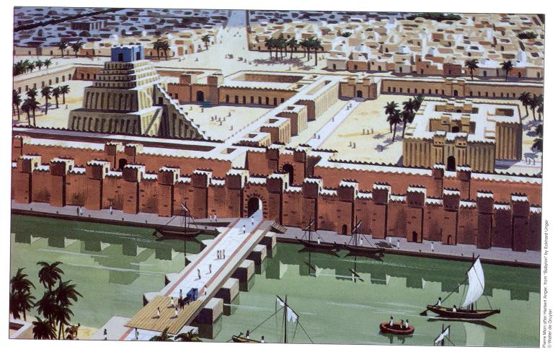
Chapter 2 Lecture Outline: “The Four Early River Valley Civilizations”
City-States in Mesopotamia
C. Babylonian Empire
1. Overtook Sumerians around 2,000 B.C.
2. Built capital, Babylon, on Euphrates river
PP Design of T. Loessin; Akins H.S.

Slide 21
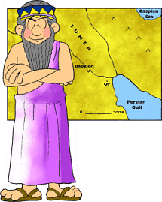
Chapter 2 Lecture Outline: “The Four Early River Valley Civilizations”
City-States in Mesopotamia
C. Babylonian Empire
1. Overtook Sumerians around 2,000 B.C.E.
2. Built captial, Babylon, on Euphrates river
3. Reign of Hammurabi [1792-1750 B.C.E.]
PP Design of T. Loessin; Akins H.S.
Notes:
The Babylonian civilization, which endured from the 18th until the 6th century BC, was, like the Sumerian that preceded it, urban in character, although based on agriculture rather than industry. The country consisted of a dozen or so cities, surrounded by villages and hamlets. At the head of the political structure was the king, a more or less absolute monarch who exercised legislative and judicial as well as executive powers.
The Babylonians modified and transformed their Sumerian heritage in accordance with their own culture and ethos. The resulting way of life proved to be so effective that it underwent relatively little change for some 1200 years. It exerted influence on all the neighboring countries, especially the kingdom of Assyria, which adopted Babylonian culture almost in its entirety.
More than 1200 years had elapsed from the glorious reign of Hammurabi to the subjugation of Babylonia by the Persians. During this long span of time the Babylonian social structure, economic organization, arts and crafts, science and literature, judicial system, and religious beliefs underwent considerable modification, but generally only in details, not in essence. Grounded almost wholly on the culture of Sumer, Babylonian cultural achievements left a deep impression on the entire ancient world, and particularly on the Hebrews and the Greeks. Even present-day civilization is indebted culturally to Babylonian civilization to some extent. For instance, Babylonian influence is pervasive throughout the Bible and in the works of such Greek poets as Homer and Hesiod, in the geometry of the Greek mathematician Euclid, in astronomy, in astrology, and in heraldry. Babylonian legal concepts have been inherited, in one form or another, by many civilizations around the world. Babylonian art and architecture continues to amaze contemporary historians. One such example, a wonder of the ancient world, was the Babylonian Hanging Gardens.

